Slide 1
Correlation
Numerical summaries of data

Slide 2
how to use Oak lessons

Slide 3
I can recognise relationships between bivariate data represented on a scatter graph.

Slide 4
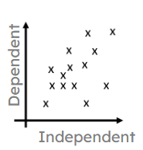
A scatter graph is a visual representation for bivariate data. It can be useful when determining the nature of the relationship between the two variables.
The relationship between two variables is linear when they change together at a constant rate.

Slide 5
Correlation describes the extent to which the relationship is close to a linear relationship.
Correlation may be positive or negative, depending on whether one variable generally increases as another increases or whether it decreases.

Slide 6

Correlation
Recognising correlation in bivariate data
Interpreting bivariate data without correlation

Slide 7
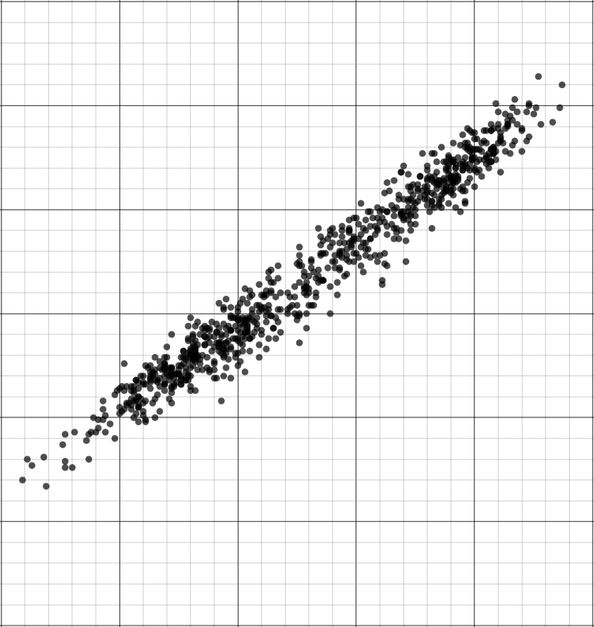
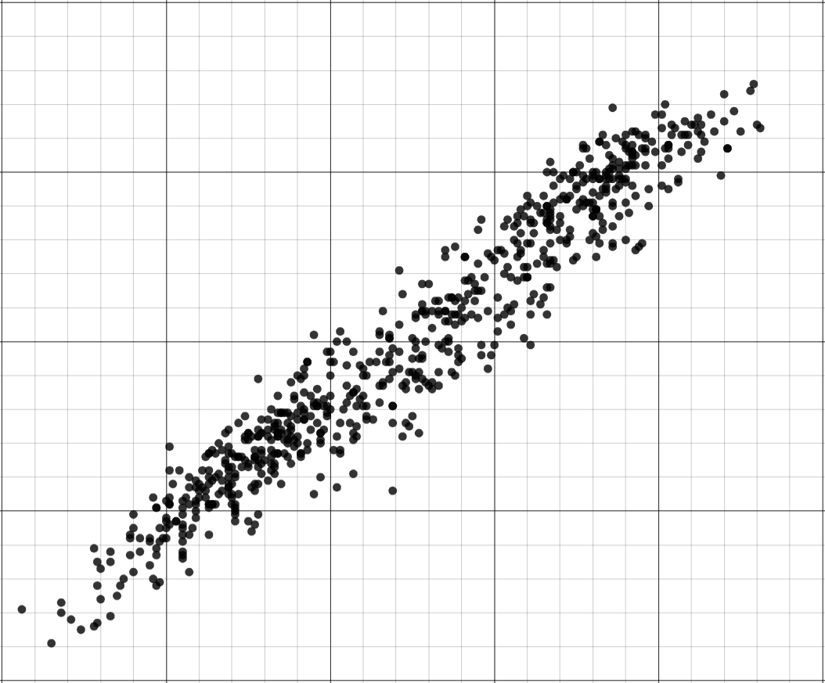
Recognising correlation in bivariate data
Here are two scatter graphs, where their points appear to form a shape.
How do the shapes of the points differ between the graphs?
upward sloping line
downward sloping line
250
200
200
150
150
dependent variable
dependent variable
100
100
50
50
0
0
0
10
20
30
40
0
10
20
30
40
independent variable
independent variable

Slide 8
Recognising correlation in bivariate data
When the points in a scatter graph appear to form shape or pattern, it can suggest that there may be an association between the two variables.
As the independent variable increases, the dependent variable also increases.
250
200
dependent variable
150
100
50
0
0
10
20
30
40
independent variable

Slide 9
Recognising correlation in bivariate data
When the points in a scatter graph appear to form shape or pattern, it can suggest that there may be an association between the two variables.
As the independent variable increases, the dependent variable decreases.
200
150
dependent variable
100
The word correlation describes the extent to which the association is close to a linear association.
50
0
0
10
20
30
40
independent variable

Slide 10
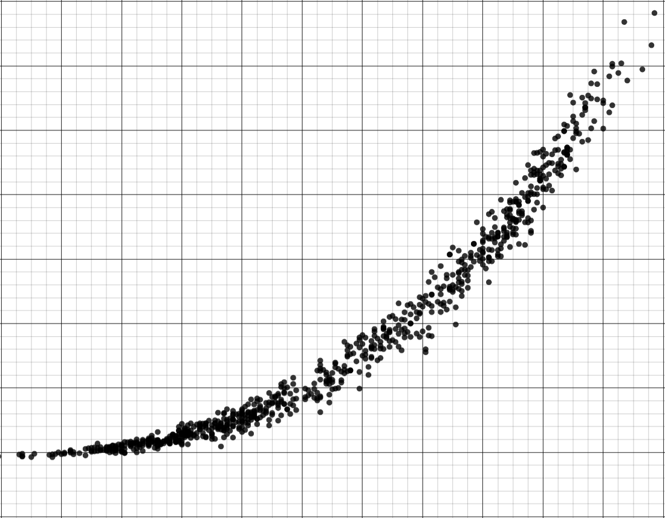
Recognising correlation in bivariate data
When the points appear to form a straight line, it suggests that the rate of change is constant throughout the data.
straight line
not a straight line
250
350
300
200
250
50
150
10
200
100
100
150
50
10
10
100
50
30
50
10
0
0
0
10
20
30
40
0
10
20
30
40
rate of change constant
rate of change not constant

Slide 11
Recognising correlation in bivariate data
When the variables change at the same rate throughout the data, there is correlation.
correlation
non-linear association
250
350
300
200
250
50
150
10
200
100
100
150
50
10
10
100
50
30
50
10
0
0
0
10
20
30
40
0
10
20
30
40
rate of change constant
rate of change not constant

Slide 12
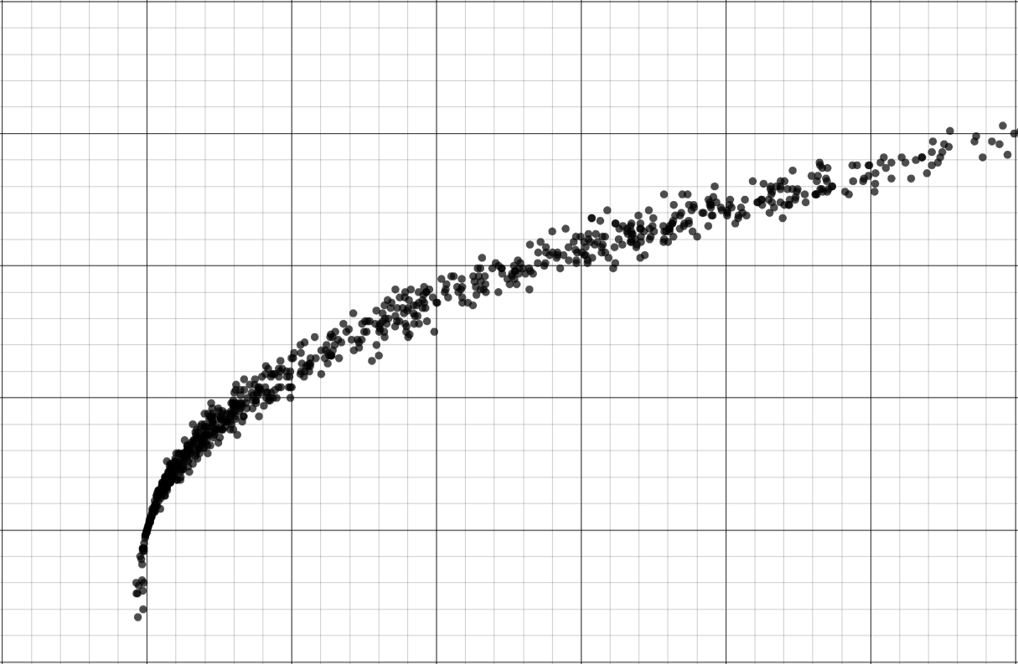
Recognising correlation in bivariate data
When the variables change at the same rate throughout the data, there is correlation.
correlation
non-linear association
10
200
-65
200
150
10
-65
150
20
100
10
100
60
50
50
10
0
0
0
10
20
30
40
0
10
20
30
40
50
60
rate of change constant
rate of change not constant

Slide 13
Recognising correlation in bivariate data
Correlation can be positive or negative, depending on the gradient of the line.
When the points form an upward sloping line, we can describe the variables as having positive correlation.
250
200
50
dependent variable
150
10
100
Each time the independent variable increases by 10, the dependent variable increases by 50.
50
50
10
0
0
10
20
30
40
independent variable

Slide 14
Recognising correlation in bivariate data
Correlation can be positive or negative, depending on the gradient of the line.
10
When the points form an downward sloping straight line, we can describe the variables as having negative correlation.
200
-65
150
10
-65
dependent variable
100
Each time the independent variable increases by 10, the dependent variable decreases by 65.
50
0
0
10
20
30
40
independent variable

Slide 15
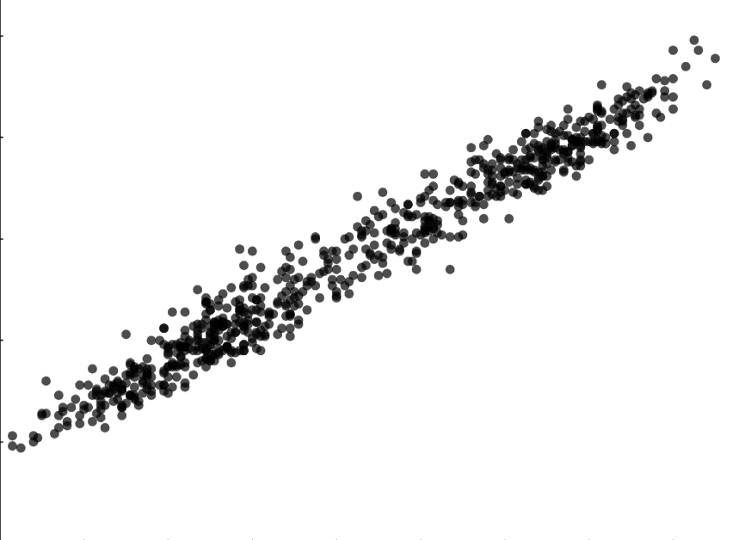
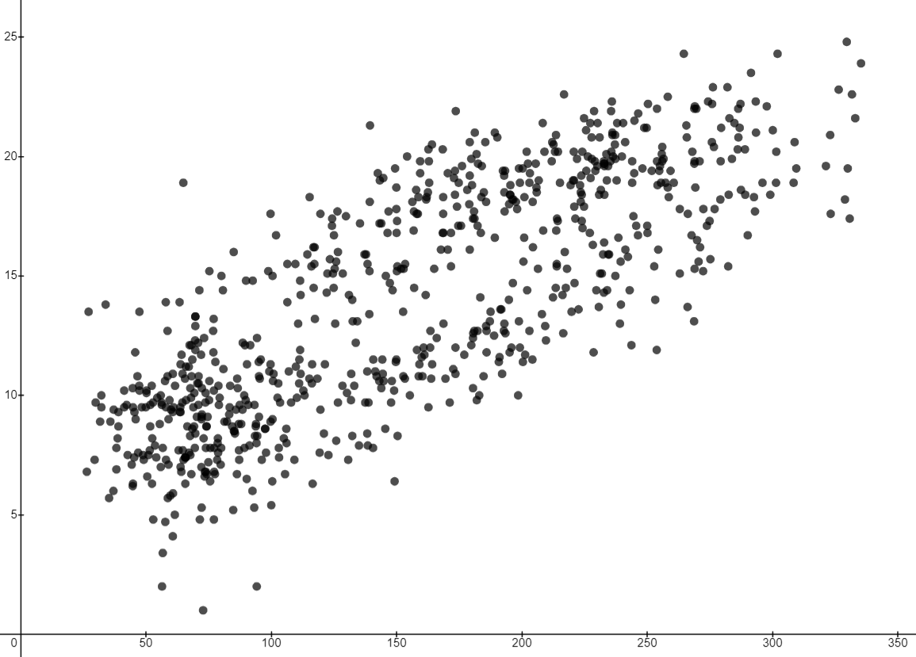
Recognising correlation in bivariate data
Correlation can be clearer to see in some bivariate data than in others.
The scatter graphs show weather data from the Met Office in Eastbourne for each month from 1941 to 2011. They both show correlation.
mean daily maximum temperature (℃)
mean daily maximum temperature (℃)
mean daily minimum temperature (℃)
total sunshine duration (hrs)

Slide 16
Recognising correlation in bivariate data
What word describes the extent to which the association is close to a linear association?
correlation

Slide 17
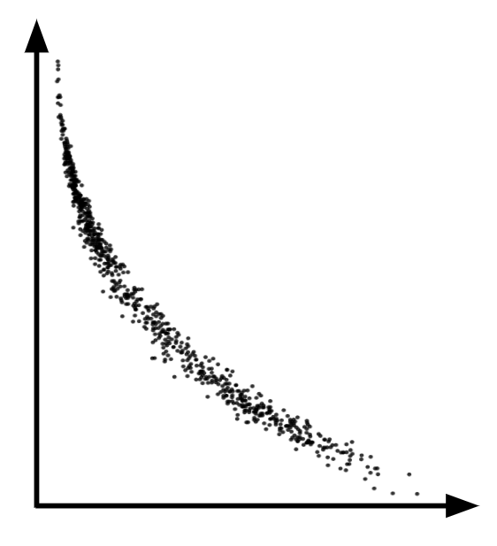
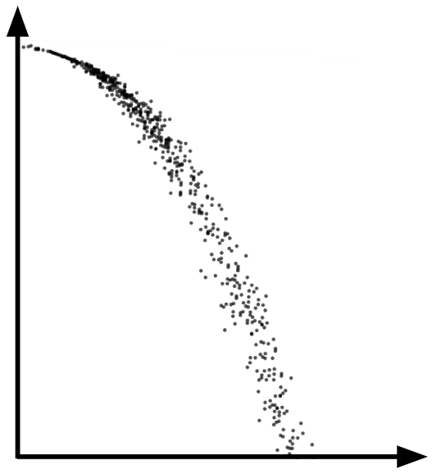
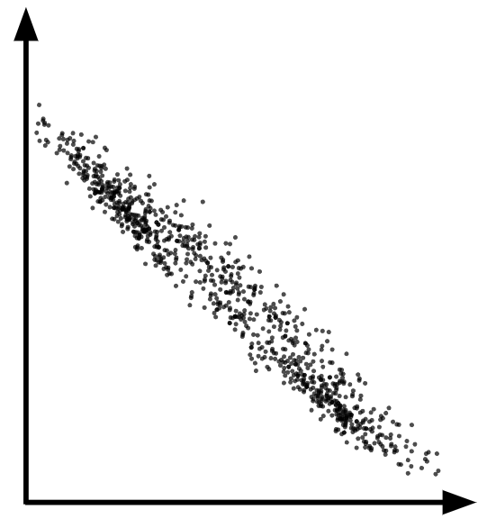

Recognising correlation in bivariate data
Which scatter graph shows a linear association?

Slide 18
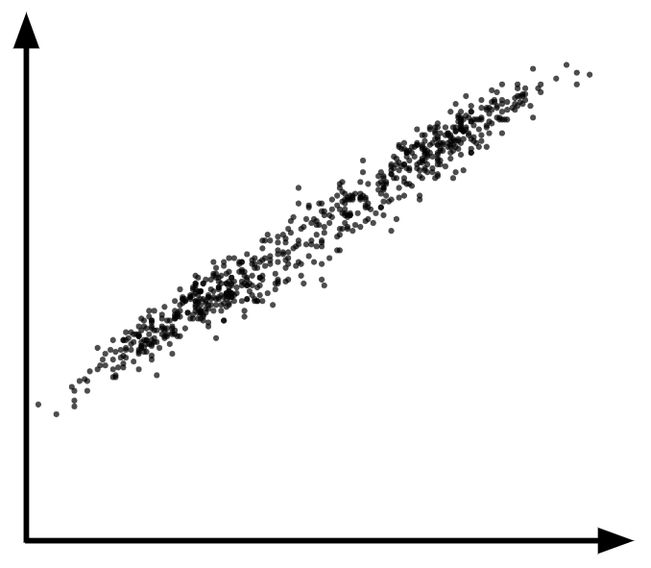
Recognising correlation in bivariate data
Fill in the missing word to describe the correlation.
positive
The variables have correlation.

Slide 19
Recognising correlation in bivariate data
Fully describe the association shown in the scatter graph.
negative correlation

Slide 20
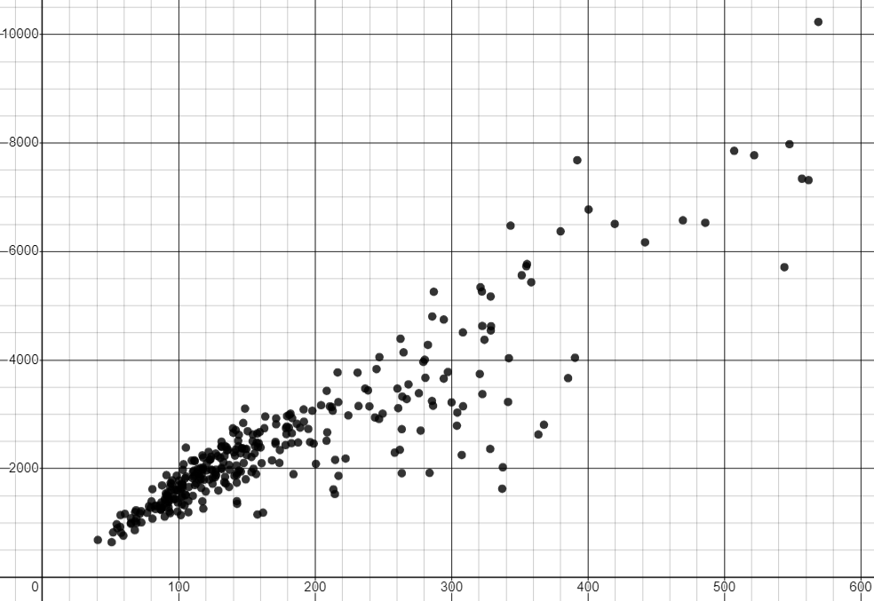

Recognising correlation in bivariate data
Correlation describes the extent to which the relationship is close to a linear relationship. In some cases, one variable may be having an affect on the other variable.
The scatter graph shows data from the ONS and gov.uk for 2019. Each point represents a region in England and Wales .
There is a positive correlation between the population of a region and the number of properties sold.
number of property sales
It looks like having more people living in a region causes more property sales.
Aisha
population (thousands)

Slide 21
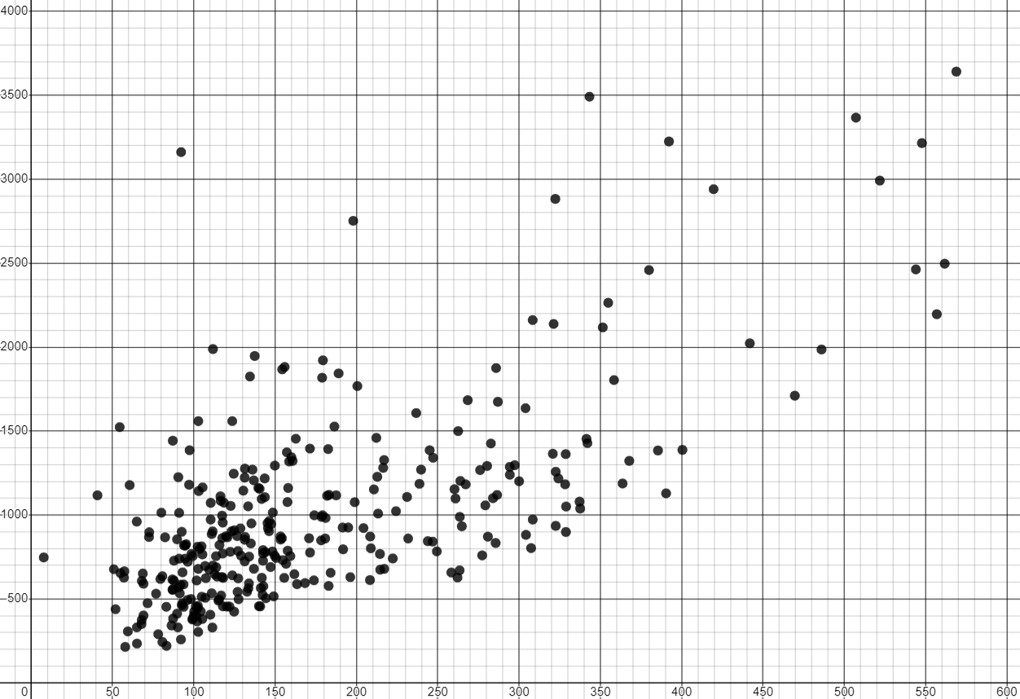

Recognising correlation in bivariate data
Correlation describes the extent to which the relationship is close to a linear relationship. In some cases, one variable may be having an affect on the other variable.
The scatter graph shows data from gov.uk for 2019. Each point represents a region in England and Wales .
There is a positive correlation between the population of a region and the amount of greenhouse gas emissions in that region.
greenhouse gas emissions (kt CO2e)
It looks like having more people in a region leads to more greenhouse gasses being emitted in that area.
Jun
population (thousands)

Slide 22
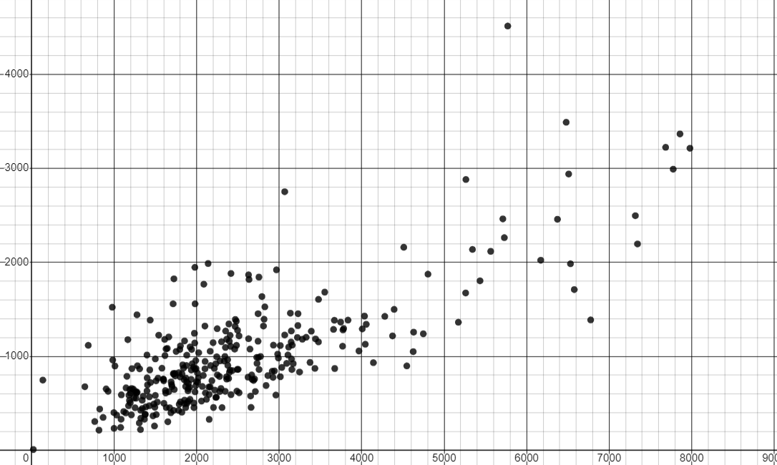

Recognising correlation in bivariate data
Correlation does not always mean that one variable is affecting the other.
Two variables may be associated without one directly affecting the other.
The scatter graph shows data from the ONS and gov.uk for 2019. Each point represents a region in England and Wales .
There is a positive correlation between the number of property sales and greenhouse gas emissions.
total greenhouse gas emissions (kt CO2e)
It looks like selling properties causes greenhouse gas emissions. But that does not seem right.
Alex
number of property sales

Slide 23
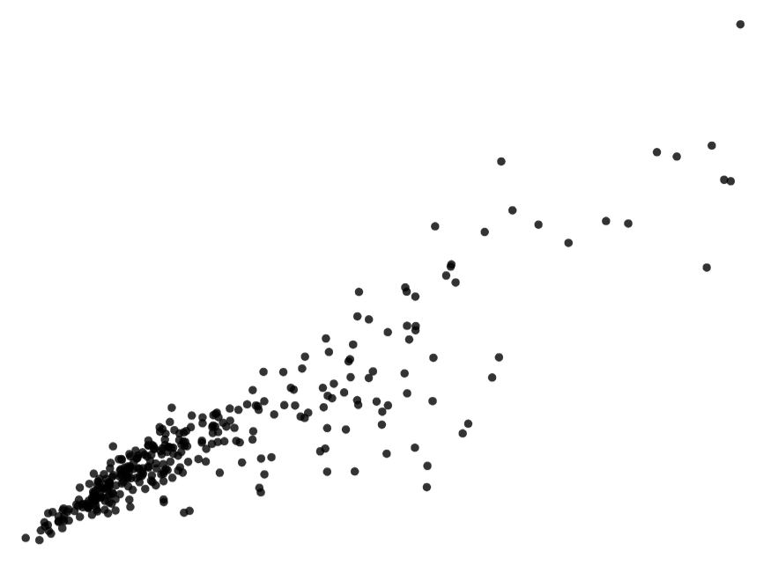
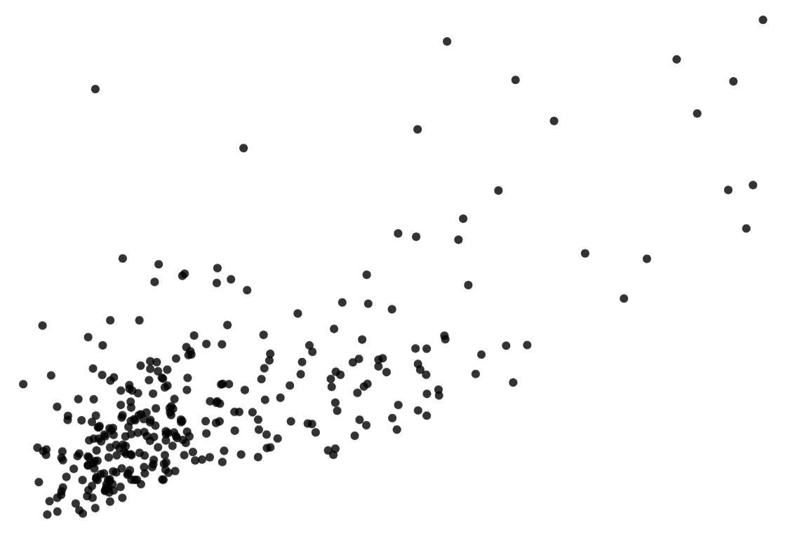
Recognising correlation in bivariate data
The explanation for why two variables correlate can sometimes be because there is a third variable that is having an effect on each of them.
The population of a region affects the number of properties sold.
The population of a region affects the amount of emissions.
property sales
greenhouse gas emissions
population
population
population
property sales
population
emissions

Slide 24
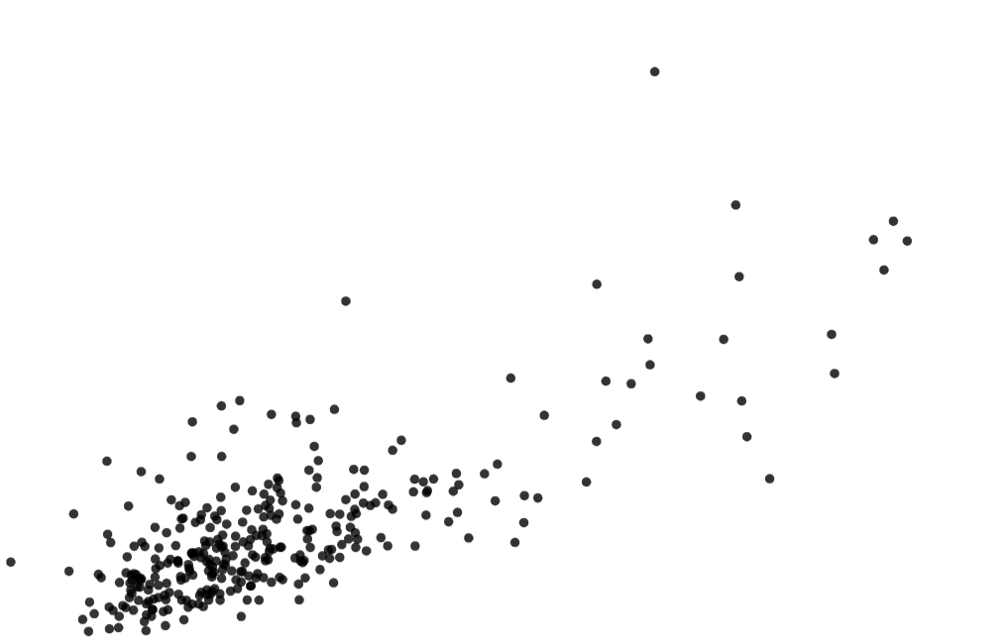
Recognising correlation in bivariate data
An increase in the population could cause an increase in property sales and an increase in the amount of emissions.
This could explain why there is a correlation between property sales and greenhouse gas emissions without one having an effect on the other.
property sales
greenhouse gas emissions
associated
population size
greenhouse gas emissions
property sales

Slide 25


Recognising correlation in bivariate data
Andeep and Sofia collect data from a sample of music students.
They ask them what their score was on their last musical performance exam and how many hours they spent practising for it.
Assuming that there is a correlation between the variables, whose prediction seems most likely?
I expect there to be a negative correlation. This would mean that the more time someone spends practising, the lower they will score on the exam.
I expect there to be a positive correlation. This would mean that the more time someone spends practising, the higher they will score on the exam.
Sofia
Andeep
Sofia

Slide 26


Recognising correlation in bivariate data
Izzy and Lucas collect data from a sample of 100 m runners.
They ask how much time it took for them to finish their last 100 m race and how many hours they spent training for it.
Assuming that there is a correlation between the variables, who’s prediction seems most likely?
I expect there to be a negative correlation. This would mean that the more time someone spends training, the less time they will take to finish the race.
I expect there to be a positive correlation. This would mean that the more time someone spends training, the more time they will take to finish the race.
Izzy
Izzy
Lucas

Slide 27
Recognising correlation in bivariate data
Correlation always means that one variable is having an affect on the other.
Correlation can mean that two variables are associated without one directly affecting the other.
Variables can only correlate when one variable is affecting the other.

Slide 28
Recognising correlation in bivariate data
Assume the two variables below have a correlation. Which type of correlation would you expect?
number of bricklayers in a team
number of bricks laid in a day
positive correlation

Slide 29
Recognising correlation in bivariate data
Assume the two variables below have a correlation. Which type of correlation would you expect?
number of bricklayers in a team
time it takes to complete a project
negative correlation

Slide 30
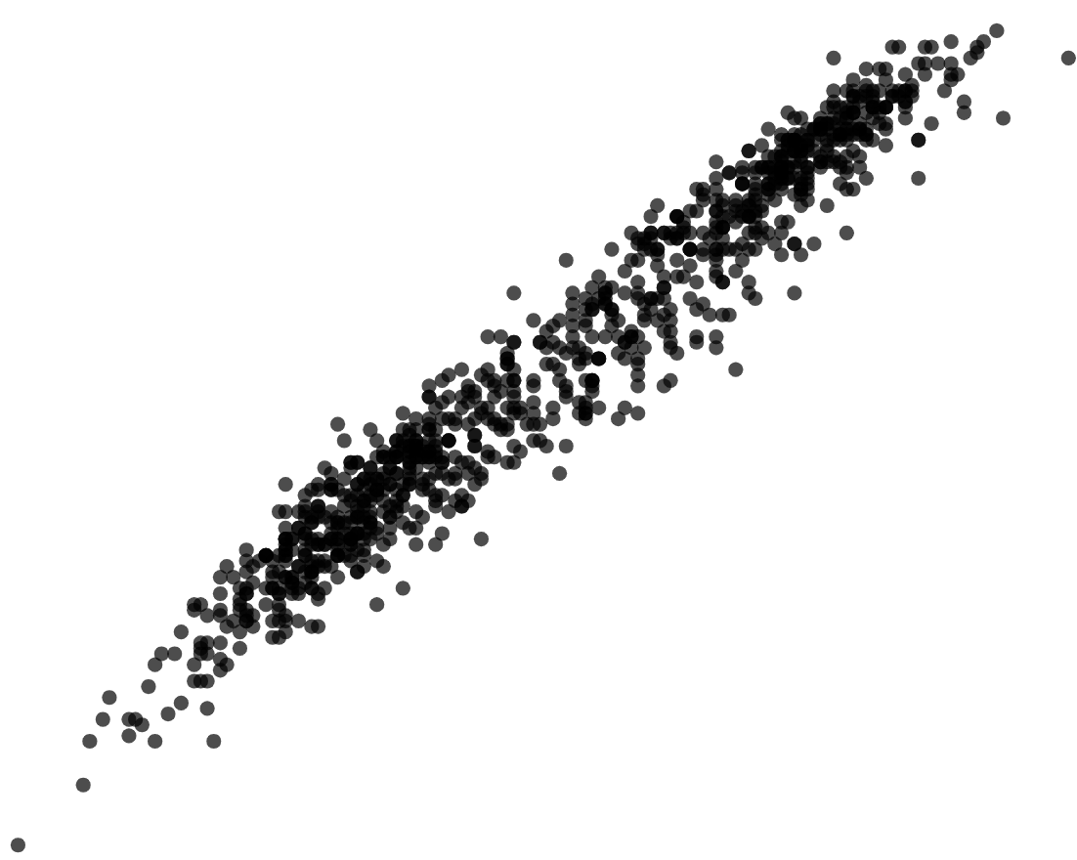
Recognising correlation in bivariate data
1) Fully describe the correlation in each scatter graph.
a)
b)
2) For each set of bivariate data, tick whether you would expect the correlation to be positive or negative.
 | positive | negative
children’s heights and their shoe sizes
steepness of a hill and walking speed up the hill

Slide 31
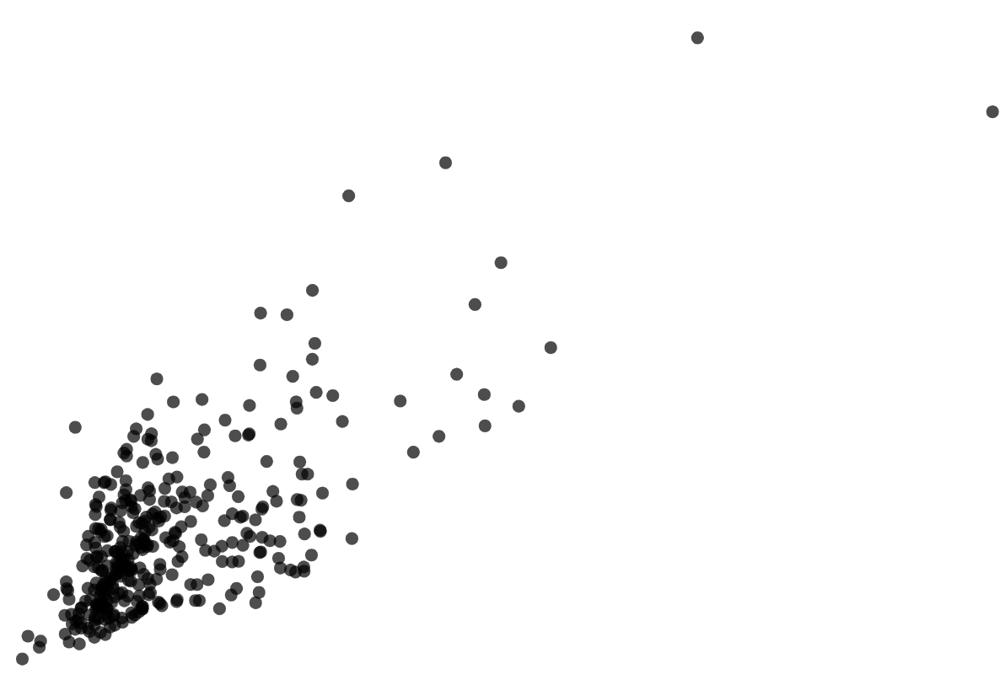
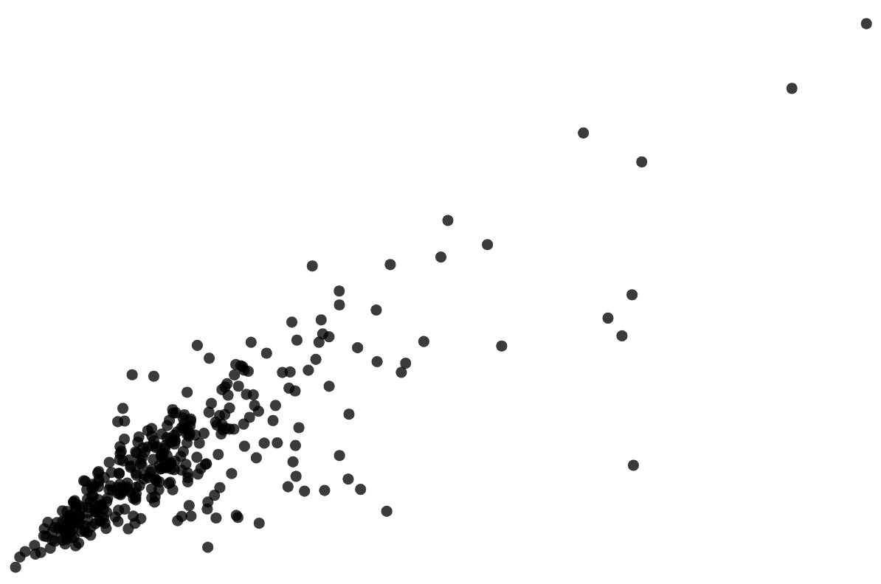
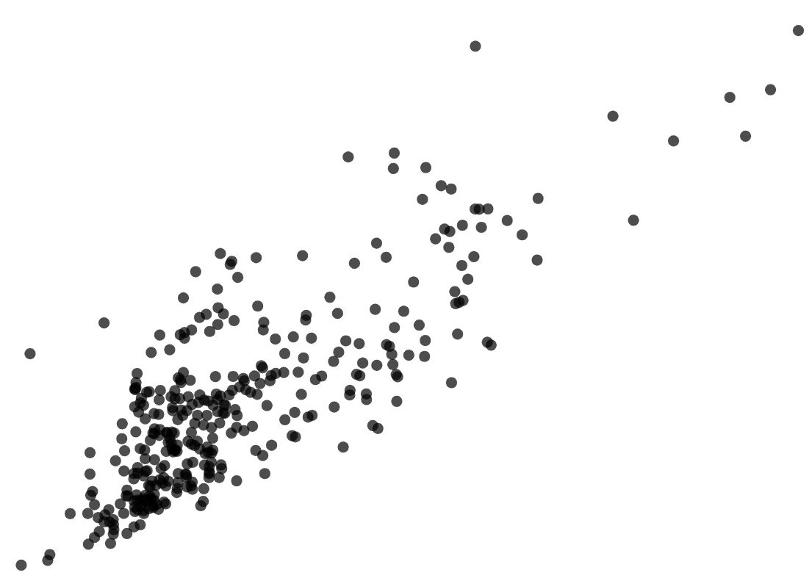
Recognising correlation in bivariate data
3) The three scatter graphs show data from the Office for National Statistics. Each point represents a region in England and Wales in 2015.
transport emissions
cell phone towers
transport emissions
population
population
cell phone towers
Jacob thinks that the third scatter graph shows that cell phone towers cause more traffic pollution because there is a positive correlation.
Explain why Jacob could be wrong.

Slide 32
Recognising correlation in bivariate data
1) Fully describe the correlation in each scatter graph.
a)
b)
positive correlation
negative correlation
2) For each set of bivariate data, tick whether you would expect the correlation to be positive or negative.
 | positive | negative
children’s heights and their shoe sizes
steepness of a hill and walking speed up the hill

Slide 33
Recognising correlation in bivariate data
3) The three scatter graphs show data from the Office for National Statistics. Each point represents a region in England and Wales in 2015.
transport emissions
cell phone towers
transport emissions
population
population
cell phone towers
Jacob thinks that the third scatter graph shows that cell phone towers cause more traffic pollution because there is a positive correlation.
Explain why Jacob could be wrong.

Slide 34
Recognising correlation in bivariate data
3) Jacob thinks that the third scatter graph shows that cell phone towers cause more traffic pollution because there is a positive correlation.
Explain why Jacob could be wrong.
Correlation does not always mean that one variable is affecting the other.
Correlation may suggest there is an association between the variables, not necessarily a cause and effect relationship.
The number of cell phone towers and the amount of traffic emissions could both be affected the population of the region.

Slide 35
Correlation
Recognising correlation in bivariate data
Interpreting bivariate data without correlation

Slide 36
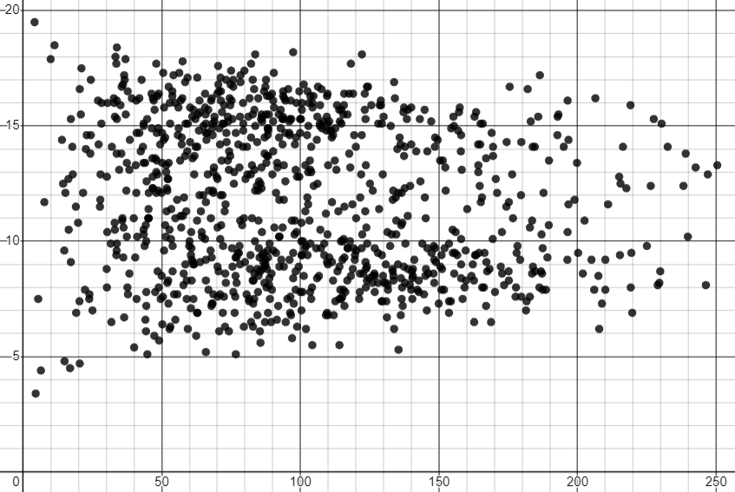
Interpreting bivariate data without correlation
Bivariate data does not always have correlation.
Sometimes the points on a scatter graph do not have a shape or pattern.
In these cases, the variables can be described as having no correlation.
The scatter graph shows monthly weather data from The Met Office for Tiree from 1941 to 2022.
mean of daily maximum temperature (℃)
No correlation can suggest that there may not be a linear association between the variables.
total rainfall (mm)

Slide 37
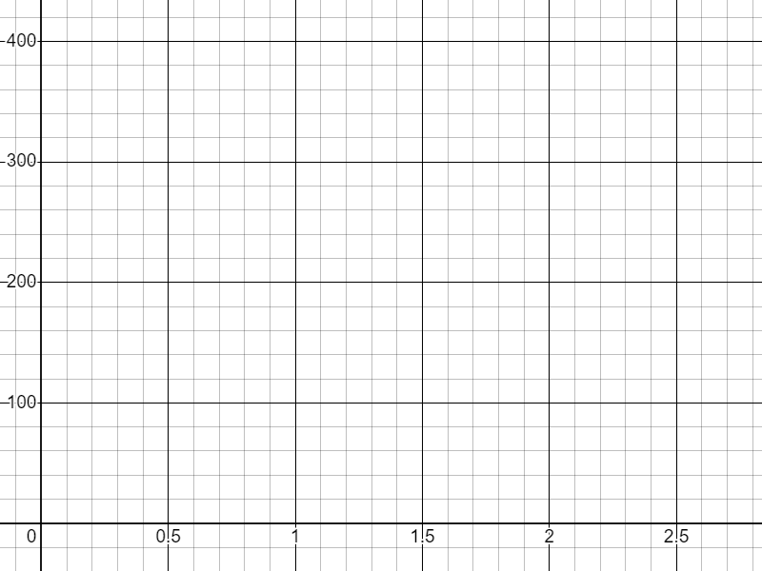
Interpreting bivariate data without correlation
Sometimes an association is better described by a curve than a straight line. Whilst correlation could be used to model these data, inspection of the scatter graph would suggest that a better description of the relationship is achievable.
This scatter graph shows the results from an experiment: timing how long it takes for a kettle to boil with different volumes of water.
time to boil (s)
In cases like this the variables have a clear association/relationship but correlation is not the best model for this association.
volume (l)

Slide 38
Interpreting bivariate data without correlation
Is correlation a good model for this data?
No, the data shows a clear curve so there is likely to be a better model than correlation.
There appears to be an association/relationship, but it is not linear.

Slide 39
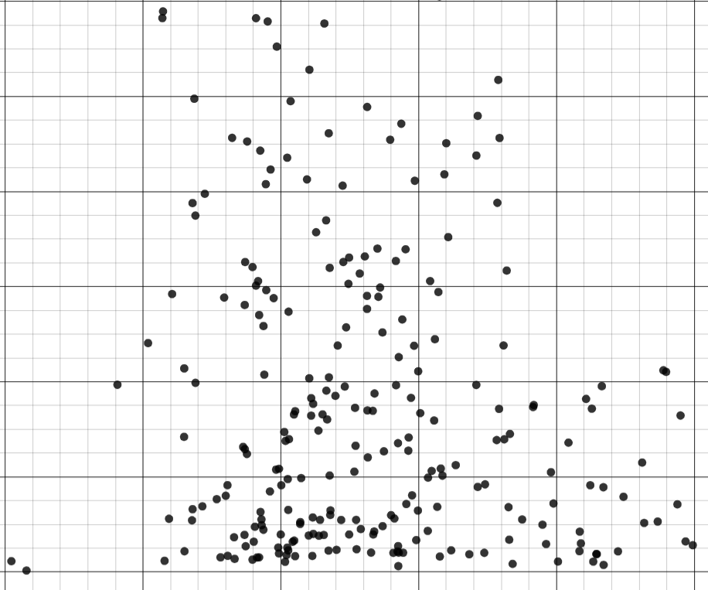
Interpreting bivariate data without correlation
Does this scatter graph show a correlation?
No, the data does not have a correlation.
There does not appear to be any relationship.

Slide 40
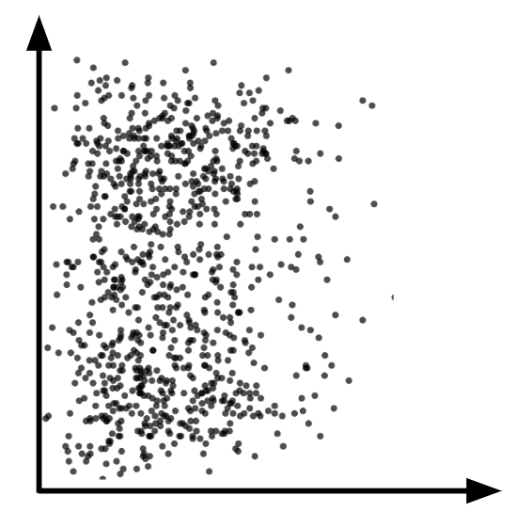
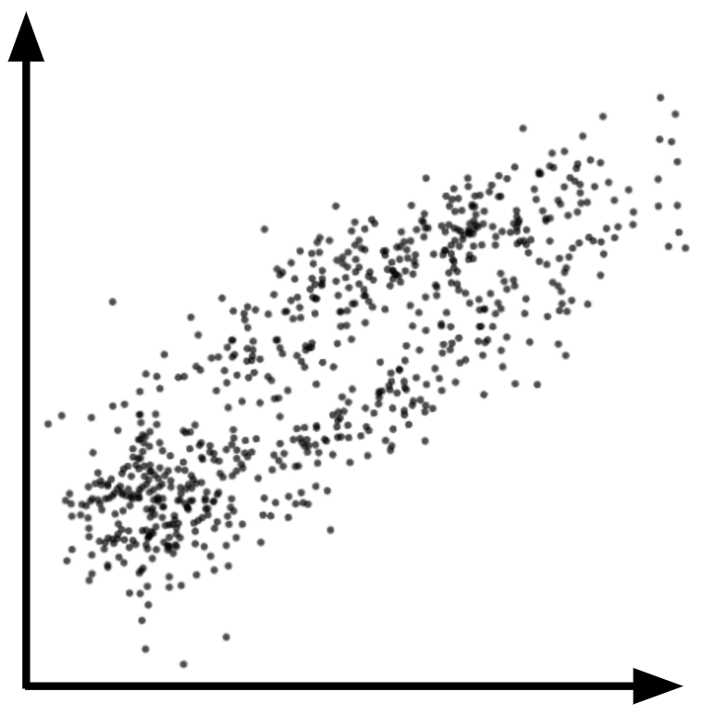
Interpreting bivariate data without correlation
Which two scatter graphs should not be described using correlation?

Slide 41
Interpreting bivariate data without correlation
Which scatter graph shows no association?

Slide 42
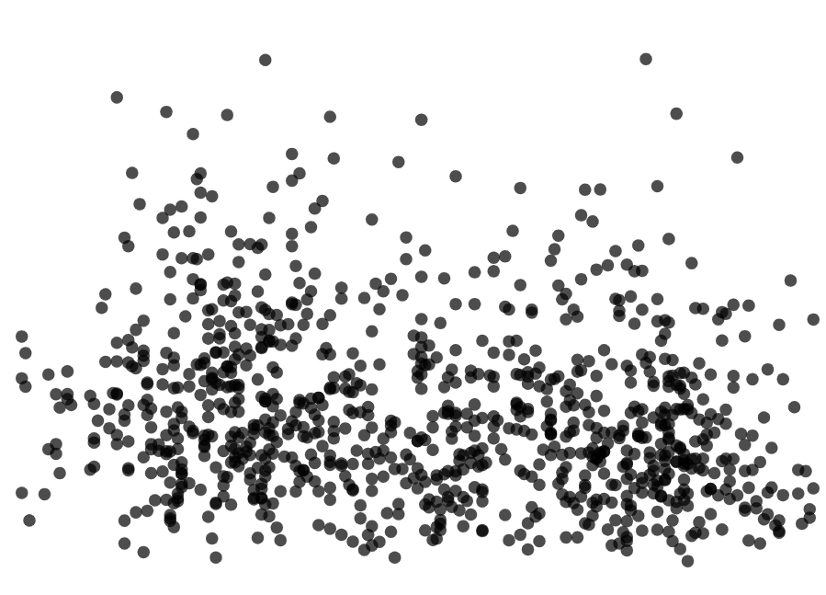
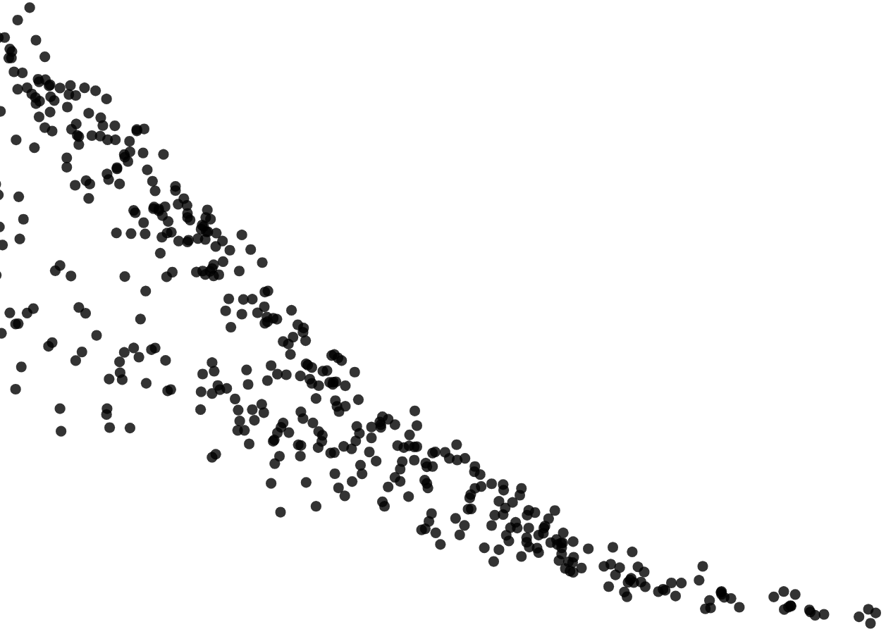
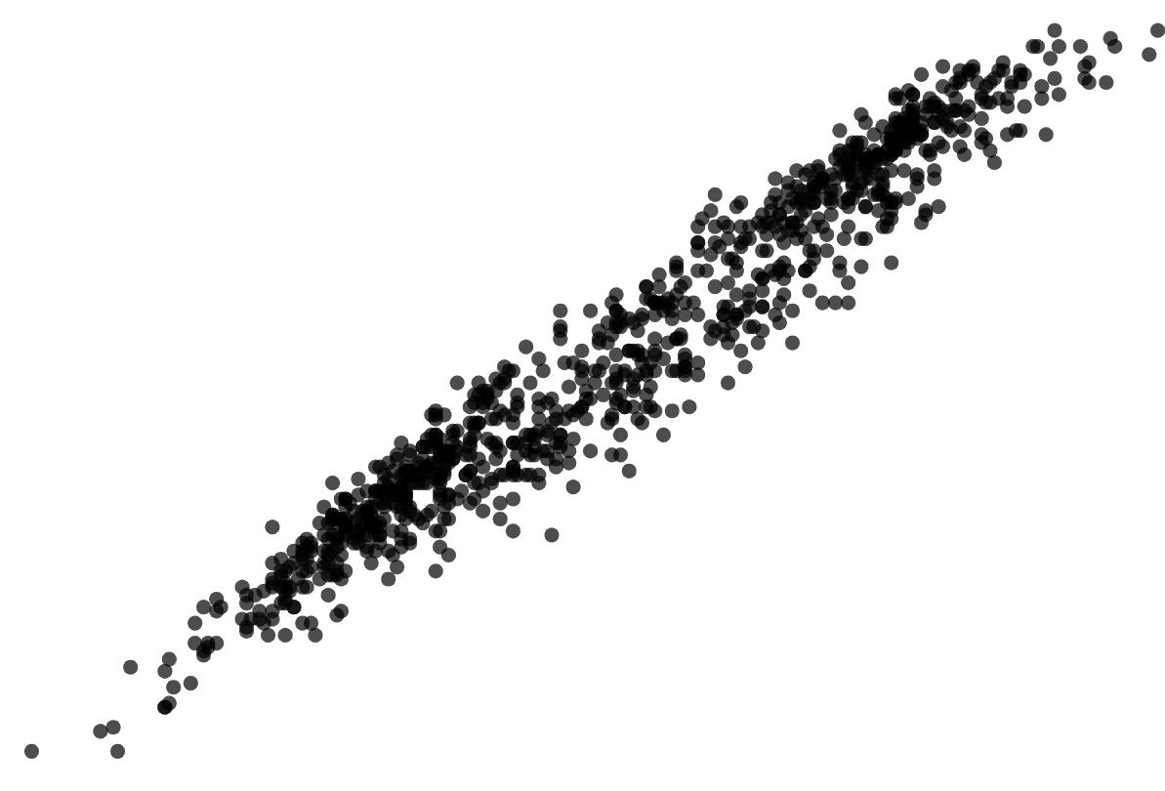
Interpreting bivariate data without correlation
1) Here are four scatter graphs.
Graph 1
Graph 2
Graph 3
Graph 4
a) Which graph shows a positive correlation?
b) Which graph shows a negative correlation?
c) Which graph shows an association which is not linear?
d) Which graph shows no association?

Slide 43
Interpreting bivariate data without correlation
1) Here are four scatter graphs.
Graph 1
Graph 2
Graph 3
Graph 4
a) Which graph shows a positive correlation?
Graph 2
b) Which graph shows a negative correlation?
Graph 3
c) Which graph shows an association which is not linear?
Graph 4
Graph 1
d) Which graph shows no association?

Slide 44
Correlation
The distribution of points on a scatter graph may suggest positive correlation.
The distribution of points on a scatter graph may suggest negative correlation.
The distribution of points on a scatter graph may suggest no correlation.
Correlation does not necessarily imply that one variable is affecting the other.

Slide 45

© Oak National Academy 2023.
Produced in partnership with Mathematics in Education and Industry.
Licensed on the Open Government Licence v3.0, except where otherwise stated. See Oak terms and conditions.

